Slide 1
Statistical Analysis and Earnings Predictions of Major League Baseball players
Brian Gordon
Regis University
MSDS 692 – Practicum I

Slide 2
Overview
Can a baseball player’s earnings be predicted by their statistics?
Perform an analysis of baseball statistics
Use machine learning techniques to trim the dataset and make earnings predictions
Evaluate performance

Slide 3
Research Notes
Target variable is earnings, features are all other statistics
Players will be assigned a single position
Team affiliation will not be considered
Inflation factor = (2016 salaries total / year[i] salaries total)
Scoring: R^2 & MAE

Slide 4
Process
Obtain data – seanlahman.com
Data cleaning & preparation
EDA visualization
Feature importance & selection using ML
ML modeling & evaluation

Slide 5
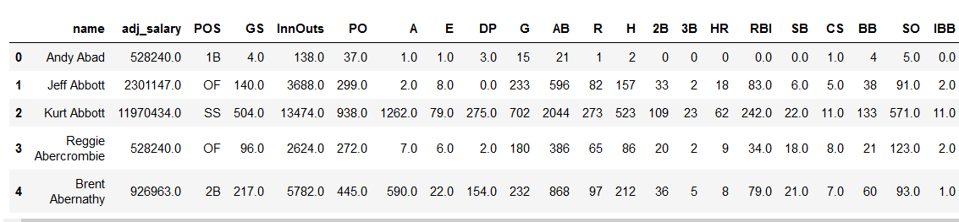
Finalized Dataset
One row per player, values combined
Went from 140k rows to 2498
26 columns remain

Slide 6
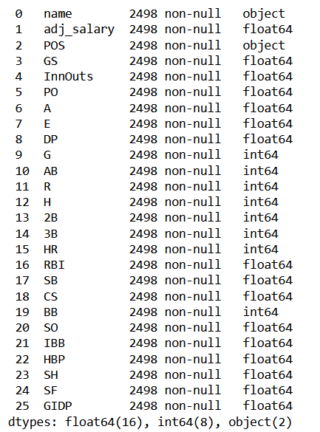
Finalized Dataset
No missing values

Slide 7
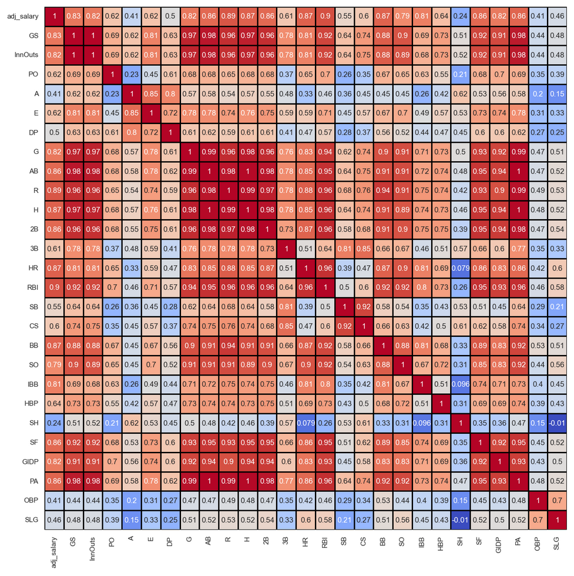
EDA/ Visualization

Slide 8
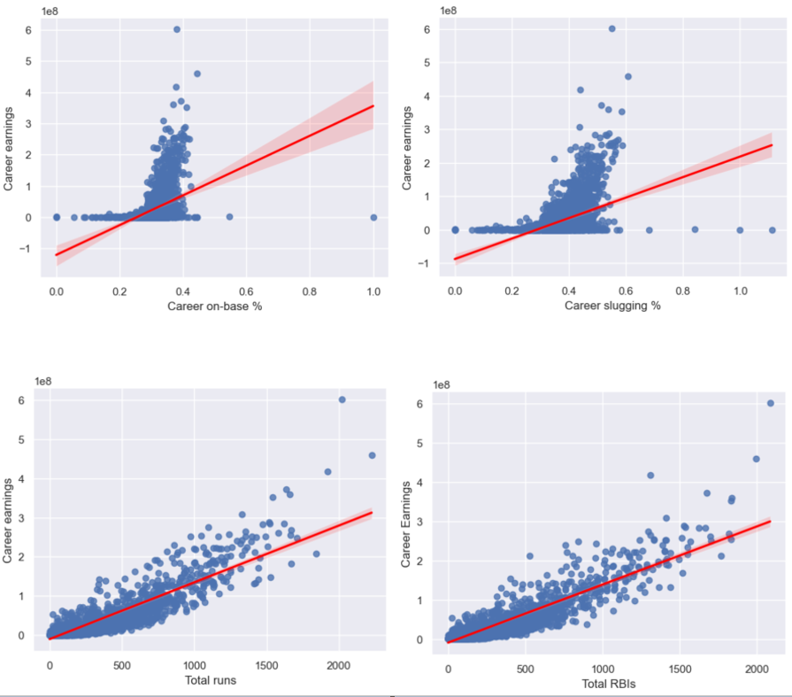
EDA/ Visualization

Slide 9
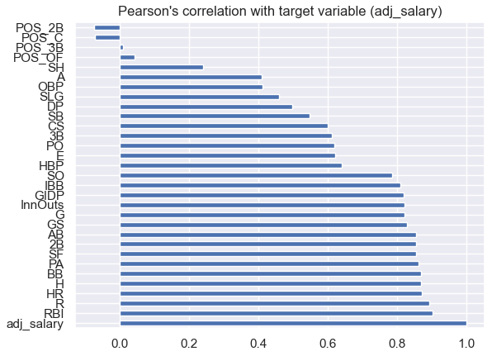
Feature Selection

Slide 10
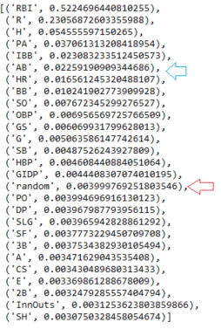
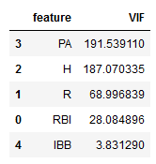
Feature Selection
RandomForestRegressor()
Variance Inflation Factor (VIF)

Slide 11
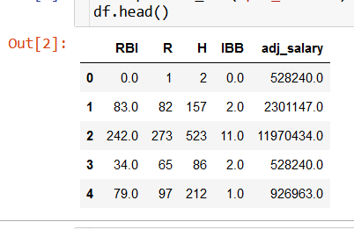
Machine Learning
Simple Linear Regression
Multiple Linear Regression
K-nearest Neighbors (random k, tuned k)
K-Fold Cross-Validation (various models; unscaled, scaled)

Slide 12
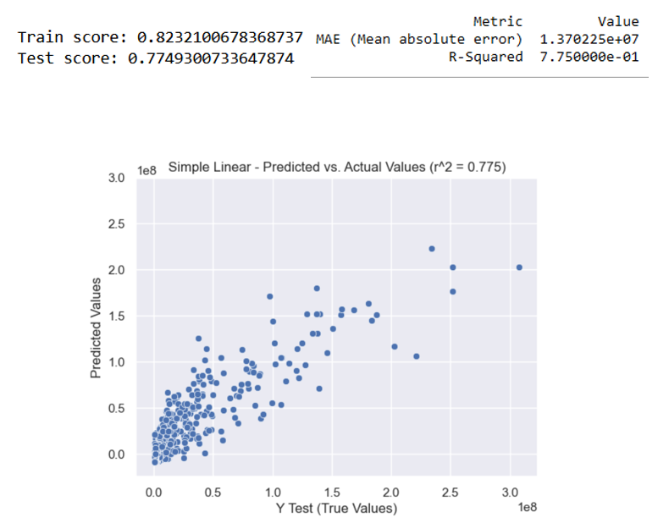
Simple Linear Regression
Predict earnings by total RBI

Slide 13
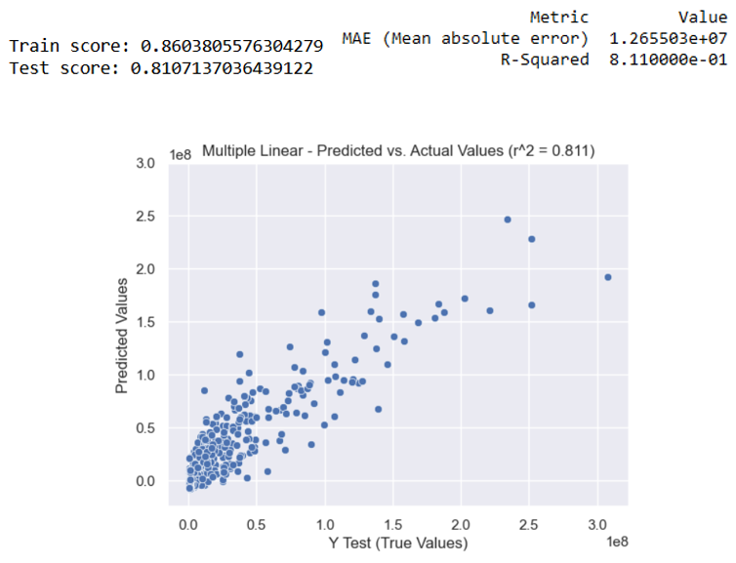
Multiple Linear Regression
Predict earnings by all features

Slide 14
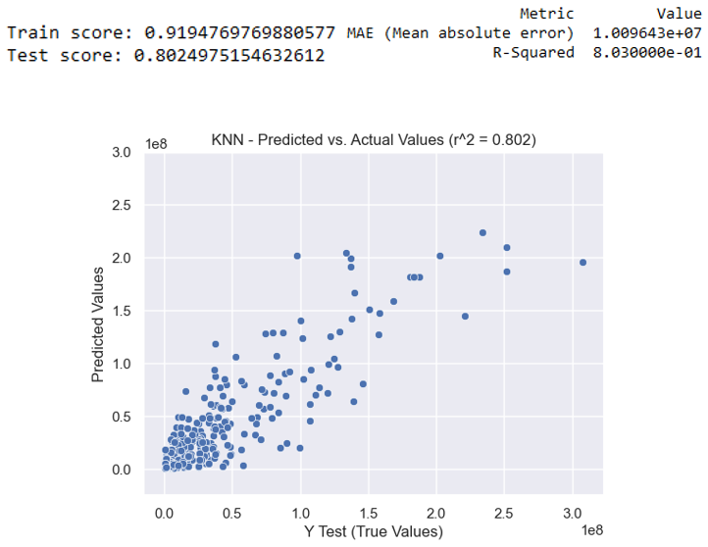
KNN Regressor
k = 3

Slide 15
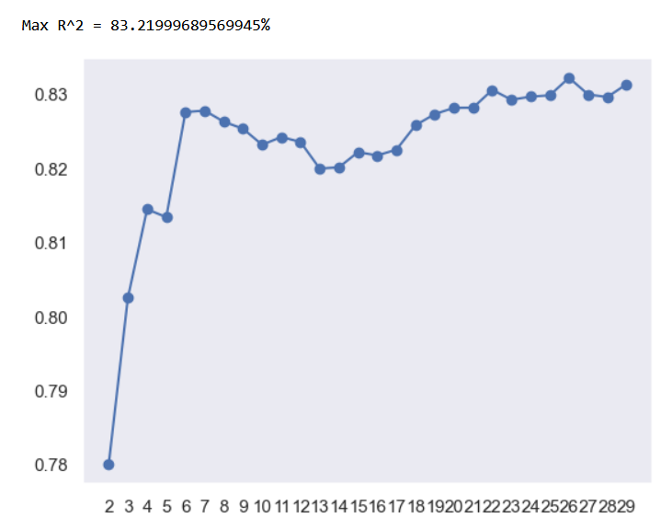
KNN Regressor – neighbor analysis

Slide 16
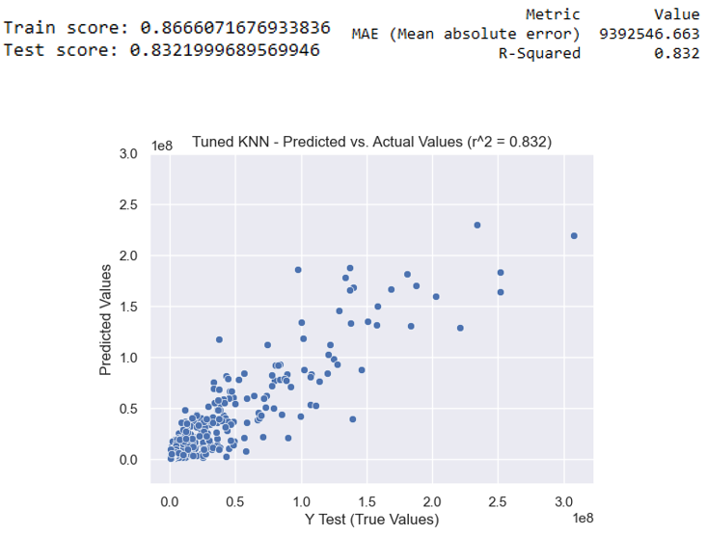
KNN Regressor
k = 26

Slide 17
K-Fold Cross-Validation
5 folds ~ 500 rows each
Scaled & unscaled data
Models used:
Regression:
Linear Regression
Lasso, LassoCV
RidgeCV
ElasticNet
Ensemble:
Ada Boost Regressor (AB)
Gradient Boosting Regressor (GBM)
Random Forest Regressor (RF)
Extra Trees Regressor (ET).

Slide 18
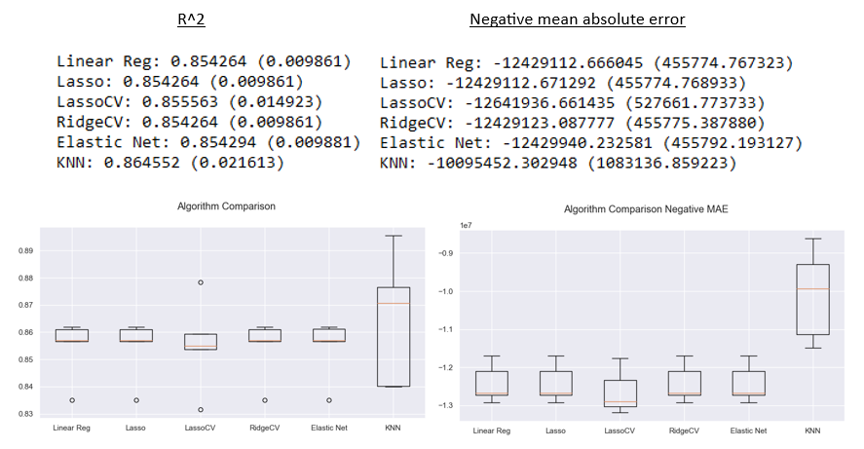
K-Fold Cross-Validation
Unscaled data

Slide 19
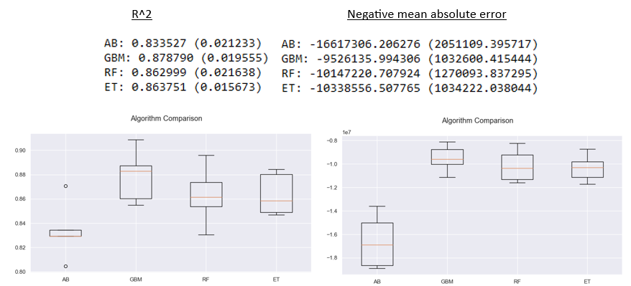
K-Fold Cross-Validation
Unscaled data

Slide 20
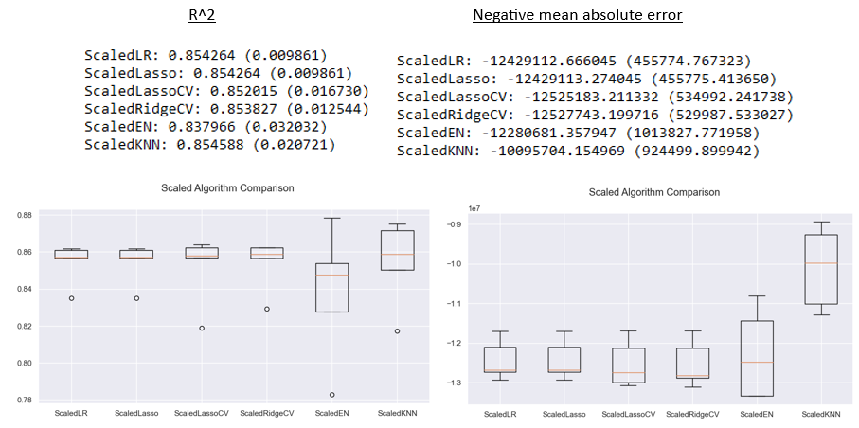
K-Fold Cross-Validation
Scaled data

Slide 21
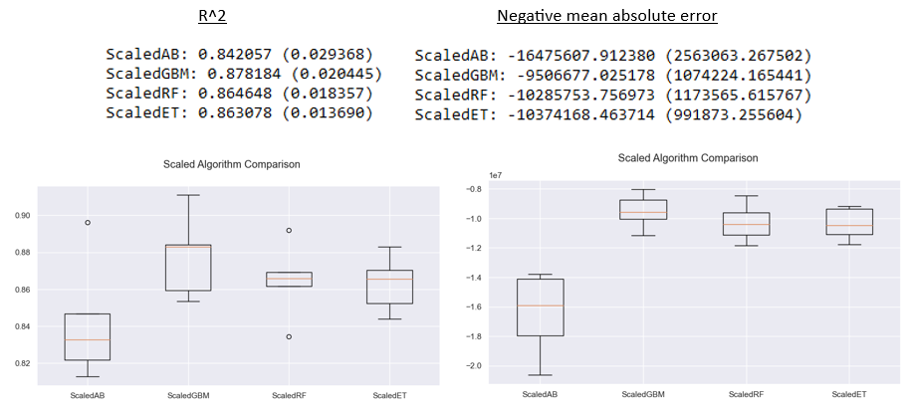
K-Fold Cross-Validation
Scaled data

Slide 22
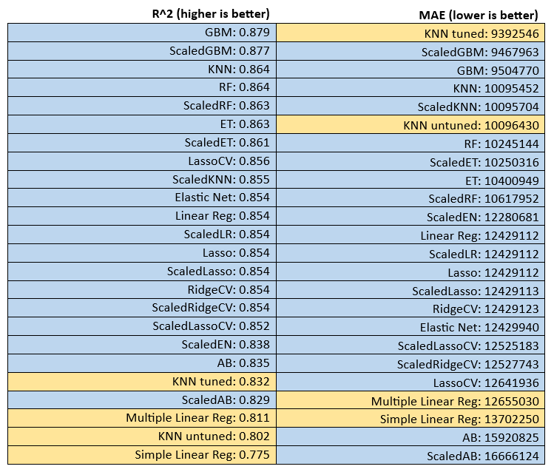
Complete Results

Slide 23
Final Analysis
Hardest part was formulating a problem that worked with the data structure
Data preprocessing is indeed the most time-consuming part of the process
The cumulative nature of the data worked well for predicting the outcome variable
High stats ~ high # years ~ multiple contracts ~ high earnings

